Slide 1
Graduate Labour Economics:
Firm size and wages.
And how government policies distort the firm-size distribution
Neil Rankin
Economics Department, Stellenbosch University
August 2017

Slide 2
A robust relationship
Why?
And how do we figure out the causal mechanism?

Slide 3
Outline
Why do larger firms pay more?
The firm-size distribution and how government regulations may distort this

Slide 4
Readings
OI and IDSON (1999)
GARICANO, LUIS, CLAIRE LELARGE, AND JOHN VAN REENEN. (2013) “Firm Size Distortions And The Productivity Distribution: Evidence From France.” Working Paper 18841. NBER Working Paper Series.
FLOWERDAY et al (2017) “Continuity and Change in South African Labor Market Regulations: the Impact of Employment Equity Act of 1998 on Employment Strategies of Firms”

Slide 5
Why do larger firms pay more?
A robust finding in empirical labour economics is that larger firms pay more (see Oi and Idson, 1999 for a review)
Why?
Something about the individuals
Something about the firms
Something else

Slide 6
Why do larger firms pay more?
Some potential theoretical explanations
Skills composition
Larger firms use more skilled labour than smaller firms
These may be observable or unobservable
Source: SAPED

Slide 7
Why do larger firms pay more?
Some potential theoretical explanations
2. Different technology choice
Small and large firms operate with distinct technologies
For example, capital investment is ‘lumpy’ and thus smaller firms would not be able to afford big pieces of machinery and would choose more labour-intensive methods of production
Higher capital-intensity in larger firms means that the marginal revenue product of workers, and thus wages, is higher

Slide 8
Why do larger firms pay more?
‘Standard’ picture

Slide 9
Why do larger firms pay more?
Source: SAPED
Notes: Coefficient estimates on size categories. Dependent variable is ln(capital stock/employee). Controls for industry (at the 2 digit level) and year.

Slide 10
Why do larger firms pay more?
Some potential theoretical explanations
Imperfections in factor (or product) markets
Different costs of capital for firms
Larger firms face lower costs of capital and thus invest in more
Or could borrow for R&D
Rent sharing
Imperfect competition means mark-ups are higher
These rents are shared between firm and workers, especially if the workers have bargaining power
What creates these rents?
Barriers to entry (natural and regulatory)
Think about SA’s collective bargaining structure

Slide 11
Why do larger firms pay more?
Imperfections in factor (or product) markets cont.
Efficiency wages
Monitoring at larger firms is more difficult
Firms pay higher wages so that opportunity cost of losing a job is higher and thus motivation not to shirk is also higher
All these arguments are based on idea that the earnings equations are missing something
Skills profile
Technology of firms
Factor or product markets

Slide 12
Why do larger firms pay more?
How would we go about figuring out which of these explanations are the most likely?
Data
Methodology

Slide 13
The firm size distribution

Slide 14
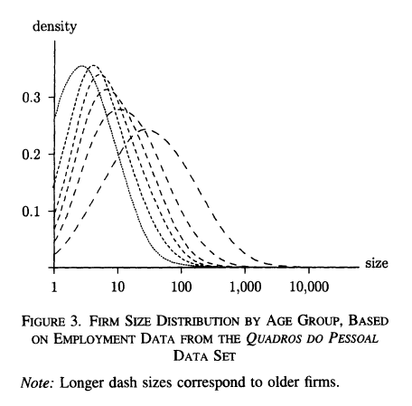
The firm size distribution
Source: Cabral and Mata (2003)

Slide 15
The firm size distribution
But there may be some things that distort the firm size distribution:
Regulations
The ‘missing middle’ in developing countries – firms either have to be small and informal, to fly under the radar, or big, to overcome fixed regulation cost
Not just a developing country, or formal vs informal firm, occurrence.
Many countries have regulations which only kick in at certain size thresholds or things like tax regulations or different minimum wages which are different below a certain size.
These may affect labour cost and thus firm size

Slide 16
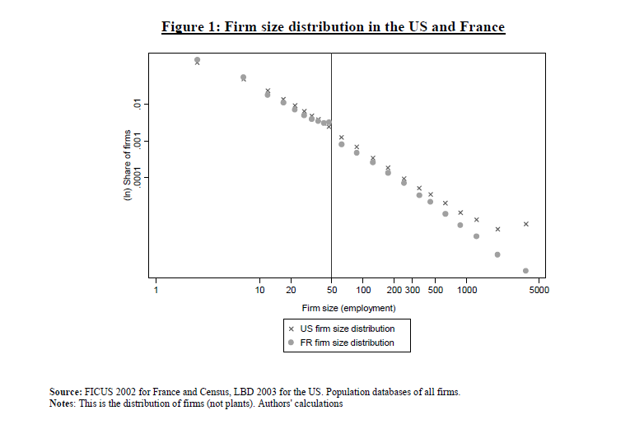
The firm size distribution – France Garicano, LeLarge, and Van Reenen (2013)
Source: Garicano, LeLarge, and Van Reenen 2013)

Slide 17
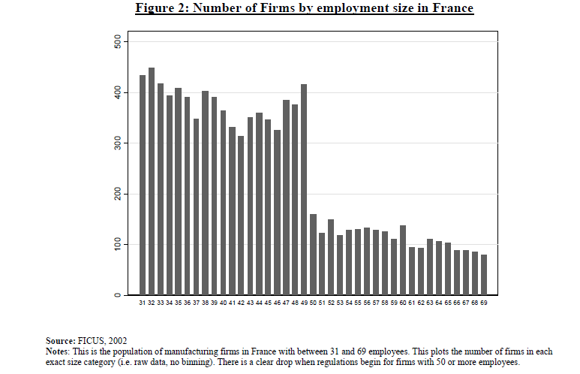
The firm size distribution - France
Source: Garicano, LeLarge, and Van Reenen 2013)

Slide 18
The firm size distribution - France
What is going on?
When firms get to the 50 employee threshold they need to undertake the following duties
They must set up a “works council” (“comité d’entreprise”) with minimum budget of 0.3% of total payroll.
They must establish a committee on health, safety and working conditions (CHSCT)
A union representative (i.e. not simply a local representative of the firm’s workers) must be appointed if wanted by workers
They must establish a profit sharing plan
They incur higher liability in case of a workplace accident
They must report monthly and in detail all of the labour contracts to the government.
Firing costs increase substantially in the case of collective dismissals of 10 or more workers. This increase is an implicit tax on firm size (e.g. Bentolila and Bertola, 1990) which makes firms reluctant to hire.
They must undertake to do a formal “Professional assessment” for each worker older than 45.

Slide 19
The firm size distribution – France, data
Data covering the universe of French firms between 2002 and 2007 (FICUS)
From various tax records
The employment measure in the FICUS relates to a headcount of the number of workers in the firm averaged over the four quarters of the fiscal year

Slide 20
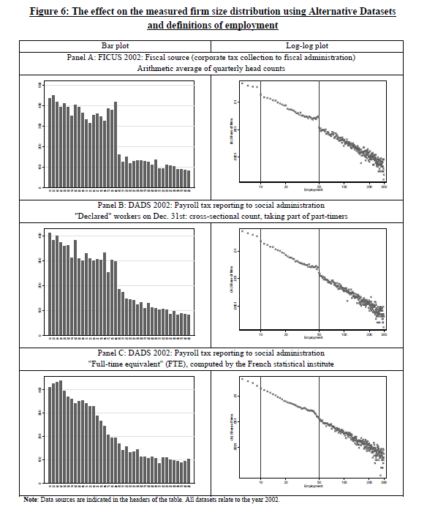
The firm size distribution - France
Source: Garicano, LeLarge, and Van Reenen 2013)

Slide 21
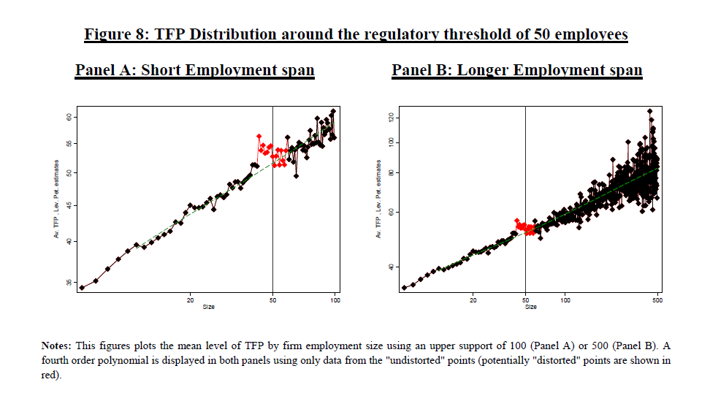
What about productivity?
Source: Garicano, LeLarge, and Van Reenen 2013)

Slide 22
The firm size distribution – France
What are the costs?
The regulation causes welfare loses by:
allocating too little employment to more productive firms who choose to be just below the regulatory threshold,
allocating too little employment to more productive firms who bear the implicit labour tax (whereas small firms do not) and
through reducing equilibrium wages (due to some tax incidence falling on workers) encourages too many agents with low managerial ability to become small entrepreneurs rather than working as employees for more productive entrepreneurs

Slide 23
What about South Africa? Flowerday et al (2017)
A number of regulations which have size thresholds. For example:
Employment Equity Act
BBBEE
Small business tax incentive
How might these affect employment?

Slide 24
South Africa
Flowerday uses a balanced panel of manufacturing firms for the years 1996 and 2001
EEA was implemented in 1998
Only applicable to firms with 50+ employees
Uncertainty about procedures etc
How did firms respond?

Slide 25
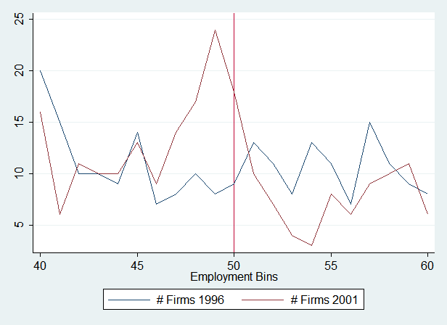
South Africa
Figure 1: Number of firms per employment bracket in 1996, and 2001

Slide 26
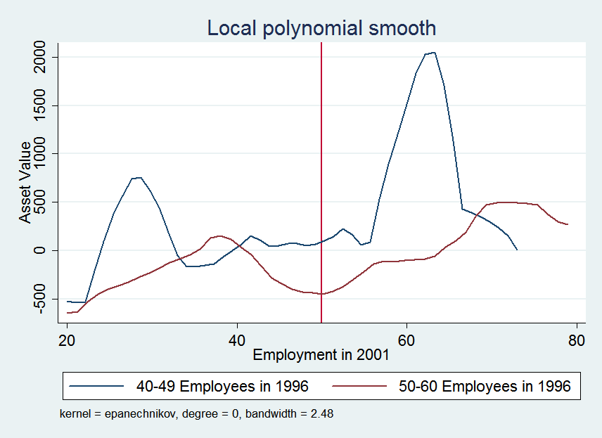
South Africa
Figure 3: Average difference in asset value of firms

Slide 27
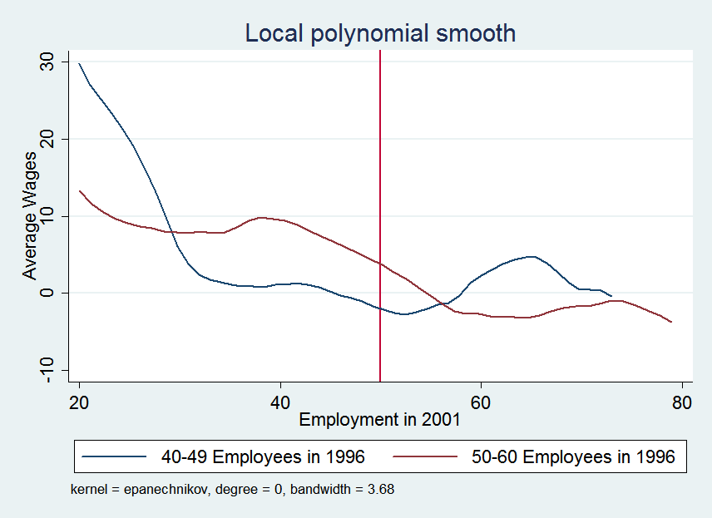
South Africa
Figure 4: Average difference in average wages per employee

Slide 28
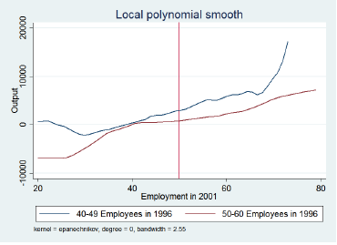
South Africa
Average difference in output

Slide 29
South Africa
Fewer firms just above the threshold and a bulge just below
Those that cross, cross by a lot and invest heavily in capital
Those just below seem to be paying higher wages
Cannot say anything about firm entry and exit (these are firms that are there in both years)
In later years 2005, 2008 does not seem to be there
Potential explanations:
Firms had learned how to deal with the regulations
The regulations were not enforced and thus had no ‘bite’

